Slide 1
PART 2
OVERVIEW

Slide 2
INTRO
SQL is a tool for organizing, managing, and retrieving data stored by a computer database.
The name "SQL" is an abbreviation for Structured Query Language.
For historical reasons, SQL is usually pronounced "sequel," but the alternate pronunciation "S.Q.L." is also used.
As the name implies, SQL is a computer language that you use to interact with a database. In fact, SQL works with one specific type of database, called a relational database.
When you need to retrieve data from a database, you use the SQL language to make the request. The DBMS processes the SQL request, retrieves the requested data, and returns it to you. This process of requesting data from a database and receiving back the results is called a database query—hence the name Structured Query Language.
SQL statements look like simple English sentences, making SQL easy to learn and understand.

Slide 3
WHY IT IS CALLED STRUCTURED QUERY LANGUAGE?
The data is stored in proper structured format, that is tabular form which consist of rows and columns.
For eg– see below STUDENTS table--
StudID | Name | Age | Gender
1 | Ram | 21 | Male
2 | Sham | 27 | Male
3 | Priya | 25 | Female
Column / Attribute / Field
Column is a place where we store similar data of same data type.
Row / Instance / Record
Row stores all the details of particular information.

Slide 4
QUICK OVERVIEW
The example is based on a simple relational database for a small distribution company. The database stores the information needed to implement a small order processing application. Specifically, it stores the following information:
Order_no | Cust | Product | Qty | Amount
112961 | 2117 | Abc | 7 | $3.530
113012 | 2111 | Mno | 35 | $31.745
112989 | 2101 | Pqr | 6 | $1.458
113051 | 2118 | Ghi | 4 | $1.420
Orders Table
Office | City | Region | Target | Sales
22 | Denver | Western | $300 | $186
11 | New York | Eastern | $575 | $692
12 | Chicago | Eastern | $800 | $735
13 | Atlanta | Eastern | $350 | $365
Offices Table

Slide 5
Cust_no | Company | Cust_rep | Credit_limit
2111 | JCP Inc. | 103 | $50,000
2101 | First Corp. | 101 | $65,000
2103 | Acme Mfg. | 105 | $50,000
2123 | Carter & Sons | 102 | $40,000
Customers Table
Name | Rep_office | Quota | Sales
Bill | 13 | $35,000 | $36,700
Mary | 11 | $30,000 | $39,200
Smith | 21 | $35,000 | $47,400
Clark | 11 | $27,000 | $29,900
SalesRep Table
The customers who buy the company's products.
The orders placed by those customers.
The salesRep who sell the products to customers, and
The offices where those salespeople work.

Slide 6
RETRIEVING DATA
list the sales offices, showing the city where each one is located and its year-to-date sales.
The SQL statement that retrieves data from the database is called SELECT.
This SQL statement retrieves the data you want:
SELECT OFFICE, CITY, SALES
FROM OFFICES
SELECT *
FROM OFFICES
Office | City | Sales
22 | Denver | $186
11 | New York | $692
12 | Chicago | $735
13 | Atlanta | $365
Office | City | Region | Target | Sales
22 | Denver | Western | $300 | $186
11 | New York | Eastern | $575 | $692
12 | Chicago | Eastern | $800 | $735
13 | Atlanta | Eastern | $350 | $365
The SELECT statement asks for three pieces of data—the city, the office number, and the sales—for each office. It also specifies that the data comes from the OFFICES table, which stores data about sales offices.
The results of the query appear, in tabular form, immediately after the request.

Slide 7
ADDING DATA TO THE DATABASE
SQL is also used to add new data to the database.
If Mary Jones (employee number 109) signs up a new customer, Acme Industries, this INSERT statement adds the customer to the database as customer no 2125 with a $25,000 credit limit:
SELECT *
FROM CUSTOMERS;
INSERT INTO CUSTOMERS (CUST_NO, COMPANY, CUST_REP, CREDIT_LIMIT)
VALUES (2125, 'Acme Industries', 109, $25,000);
Cust_no | Company | Cust_rep | Credit_limit
2111 | JCP Inc. | 103 | $50,000
2101 | First Corp. | 101 | $65,000
2103 | Acme Mfg. | 105 | $50,000
2123 | Carter & Sons | 102 | $40,000
2125 | Acme Industries | 109 | $25,000

Slide 8
DELETING DATA
Just as the SQL INSERT statement adds new data to the database, the SQL DELETE
statement removes data from the database.
If Acme Industries decides a few days later to switch to a competitor, you can delete them from the database with this statement:
DELETE FROM CUSTOMERS
WHERE COMPANY = 'Acme Industries’;
SELECT *
FROM CUSTOMERS;
Cust_no | Company | Cust_rep | Credit_limit
2111 | JCP Inc. | 103 | $50,000
2101 | First Corp. | 101 | $65,000
2103 | Acme Mfg. | 105 | $50,000
2123 | Carter & Sons | 102 | $40,000

Slide 9
UPDATING THE DATABASE
The SQL language is also used to modify data that is already stored in the database
For example, to increase the credit limit for First Corp. to $75,000, you would use the SQL UPDATE statement:
UPDATE CUSTOMERS
SET CREDIT_LIMIT = $75.000
WHERE COMPANY = 'First Corp.'
SELECT *
FROM CUSTOMERS;
Cust_no | Company | Cust_rep | Credit_limit
2111 | JCP Inc. | 103 | $50,000
2101 | First Corp. | 101 | $75,000
2103 | Acme Mfg. | 105 | $50,000
2123 | Carter & Sons | 102 | $40,000

Slide 10
CREATING THE TABLE
Before you can store data in a database, you must first define the structure of the data.
This SQL CREATE TABLE statement defines a new table to store the products data.
CREATE TABLE PRODUCTS
(MFR_ID CHAR(3),
PRODUCT_ID CHAR(5),
DESCRIPTION VARCHAR(20),
PRICE INT,
QTY_ON_HAND INTEGER);
It assigns the name PRODUCTS to the new table and specifies the name and type of data stored in each of its five columns.
Once the table has been created, you can fill it with data. Here's an INSERT statement
INSERT INTO PRODUCTS VALUES
('ACI', '41007', 'Size 7 Widget', 225, 250);
SELECT * FROM PRODUCTS;
MRF_ID | Product_Id | Description | Price | Qty_on_hand
ACI | 41007 | Size 7 Widget | 225 | 250

Slide 11
EMPTY AND DELETE THE TABLE
If you discover later that you no longer need to store the products data in the
database, you can erase the data from table(keeping the structure as it is) or remove the table(and all of the data it contains) with the DROP and TRUNCATE.
DROP TABLE PRODUCTS;
TRUNCATE TABLE PRODUCTS;
MRF_ID | Product_Id | Description | Price | Qty_on_hand
DROP deletes everything- records as well as table structure.
TRUNCATE deletes all the records from the table but structure of table remains as it is.

Slide 12
WHAT IS DATA?
Data refers to any information or facts that can be recorded, stored, and processed.
It can be in various forms, such as text, numbers, images, audio, or video.
Examples of data include customer names, product prices, temperature readings, and more
SalesRep Table
Name | Rep_office | Quota | Sales
Bill | 13 | $35,000 | $36,700
Mary | 11 | $30,000 | $39,200
Smith | 21 | $35,000 | $47,400
Clark | 11 | $27,000 | $29,900
In short, Information that is stored in this tabular form is called DATA.
We store it in tabular form for future references, the way e store contact details in our mobiles so that in future when there is need we can call particular person.
This data is stored in any physical format like harddisk, server, etc.

Slide 13
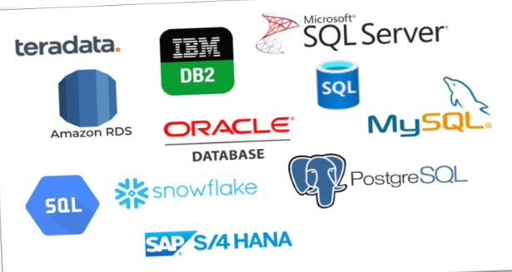
WHAT IS DATABASE?
A database is a structured collection of data that is organized for efficient storage, retrieval, and management.
It provides a way to store and manage large amounts of data in a systematic manner.
Databases can be relational (using tables) or non-relational (using other data models).
A DBMS(DATABASE MANAGEMENT SYSTEM) is software that allows users to interact with databases.
It provides tools for creating, modifying, querying, and maintaining databases.
Examples of DBMS include →

Slide 14
PRACTICAL ON MYSQL WORKBENCH

Slide 15
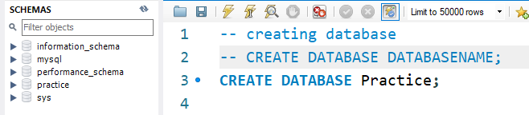
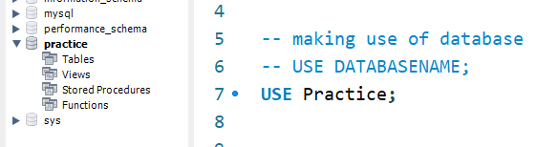
CREATE AND USE DATABASE
Create database to store various data.
Then click on refresh icon so that database is displayed in schema section
(NOTE– always end your query with “;” else it will show error.
While executing query, place your cursor on the statement and press “CTRL + ENTER”.
Sometimes there are cases that you will forget the logic behind the query, comment those queries.)
There are multiple databases present. System should know which database to use so run use database query.
You can see the database gets highlighted.

Slide 16
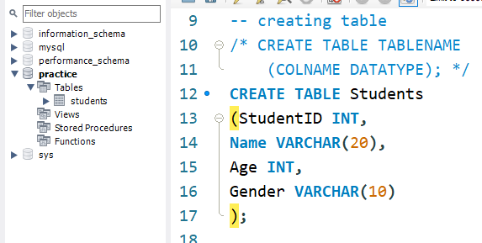
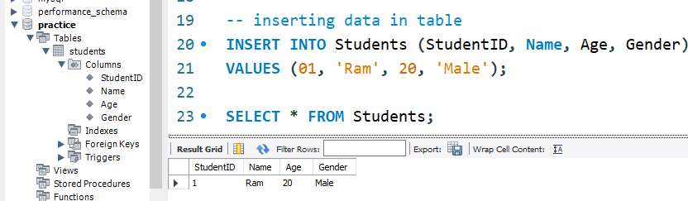
CREATE TABLE AND INSERT DATA

